Slide 1
DICE
(EXERCISE-A)

Slide 2
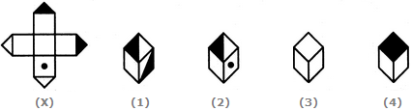
DICE (EXERCISE-A)
Q 1. Choose the box that is similar to the box formed from the given sheet of paper (X).
A. 1 and 2 only B. 2 and 4 only
C.2 and 3 only D. 1 and 4 only

Slide 3
DICE (EXERCISE-A)
Q 1. Choose the box that is similar to the box formed from the given sheet of paper (X).
A. 1 and 2 only B. 2 and 4 only
C.2 and 3 only D. 1 and 4 only

Slide 4
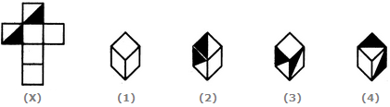
DICE (EXERCISE-A)
Q 2. Choose the box that is similar to the box formed from the given sheet of paper (X).
A. 1 and 4 only B. 3 and 4 only
C.1 and 2 only D. 2 and 3 only

Slide 5
DICE (EXERCISE-A)
Q 2. Choose the box that is similar to the box formed from the given sheet of paper (X).
A. 1 and 4 only B. 3 and 4 only
C.1 and 2 only D. 2 and 3 only

Slide 6

DICE (EXERCISE-A)
Q 3. How many dots lie opposite to the face having three dots, when the given figure is folded to form a cube?
A.2 B.4 C.5 D.6

Slide 7
DICE (EXERCISE-A)
Q 3. How many dots lie opposite to the face having three dots, when the given figure is folded to form a cube?
A.2 B.4 C.5 D.6

Slide 8
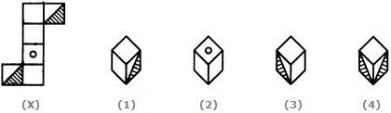
DICE (EXERCISE-A)
Q 4. Choose the box that is similar to the box formed from the given sheet of paper (X).
A.C 1 and 3 only B. 1 and 4 only
C. 2 and 4 only D. 3 and 4 only

Slide 9
DICE (EXERCISE-A)
Q 4. Choose the box that is similar to the box formed from the given sheet of paper (X).
A.1 and 3 only B. 1 and 4 only
C. 2 and 4 only D. 3 and 4 only

Slide 10
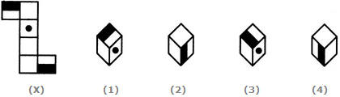
DICE (EXERCISE-A)
Q 5. Choose the box that is similar to the box formed from the given sheet of paper (X).
A. 1 and 2 only B. 2 and 3 only
C. 2 and 4 only D. 1, 2, 3 and 4

Slide 11
DICE (EXERCISE-A)
Q 5. Choose the box that is similar to the box formed from the given sheet of paper (X).
A. 1 and 2 only B. 2 and 3 only
C. 2 and 4 only D. 1, 2, 3 and 4

Slide 12
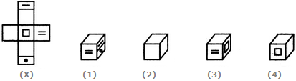
DICE (EXERCISE-A)
Q 6. Choose the box that is similar to the box formed from the given sheet of paper (X).
A. 1 only B. 1 and 3 only
C. 1, 3 and 4 only D. 1, 2, 3 and 4

Slide 13
DICE (EXERCISE-A)
Q 6. Choose the box that is similar to the box formed from the given sheet of paper (X).
A. 1 only B. 1 and 3 only
C. 1, 3 and 4 only D. 1, 2, 3 and 4

Slide 14
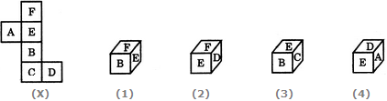
DICE (EXERCISE-A)
Q 7. Choose the box that is similar to the box formed from the given sheet of paper (X).
A.1 only B.2 only
C.1 and 3 only D.1, 2, 3 and 4 only

Slide 15
DICE (EXERCISE-A)
Q 7. Choose the box that is similar to the box formed from the given sheet of paper (X).
A.1 only B.2 only
C.1 and 3 only D.1, 2, 3 and 4 only

Slide 16
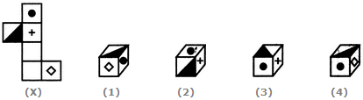
DICE (EXERCISE-A)
Q 8. Choose the box that is similar to the box formed from the given sheet of paper (X).
A.1 only B.2 only C.3 only D.4 only

Slide 17
DICE (EXERCISE-A)
Q 8. Choose the box that is similar to the box formed from the given sheet of paper (X).
A.1 only B.2 only C.3 only D.4 only

Slide 18
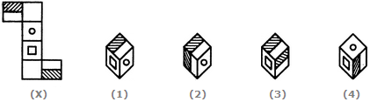
DICE (EXERCISE-A)
Q 9. Choose the box that is similar to the box formed from the given sheet of paper (X).
A.1 only B.2 only C.3 only D.4 only

Slide 19
DICE (EXERCISE-A)
Q 9. Choose the box that is similar to the box formed from the given sheet of paper (X).
A.1 only B.2 only C.3 only D.4 only

Slide 20
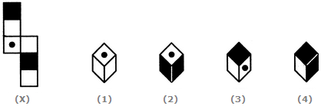
DICE (EXERCISE-A)
Q 10. Choose the box that is similar to the box formed from the given sheet of paper (X).
A.2 and 3 only B.1, 3 and 4 only
C.2 and 4 only D.1 and 4 only

Slide 21
DICE (EXERCISE-A)
Q 10. Choose the box that is similar to the box formed from the given sheet of paper (X).
A.2 and 3 only B.1, 3 and 4 only
C.2 and 4 only D.1 and 4 only

Slide 22
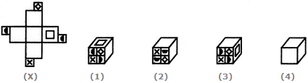
DICE (EXERCISE-A)
Q 11. Choose the box that is similar to the box formed from the given sheet of paper (X).
A.1, 2 and 3 only B.2 and 3 only
C.1, 3 and 4 only D.2, 3 and 4 only

Slide 23
DICE (EXERCISE-A)
Q 11. Choose the box that is similar to the box formed from the given sheet of paper (X).
A.1, 2 and 3 only B.2 and 3 only
C.1, 3 and 4 only D.2, 3 and 4 only

Slide 24
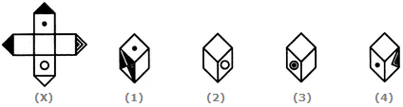
DICE (EXERCISE-A)
Q 12. Choose the box that is similar to the box formed from the given sheet of paper (X).
A.1 and 2 only B.1, 2 and 3 only
C.1 and 3 only D.1, 2, 3 and 4

Slide 25
DICE (EXERCISE-A)
Q 12. Choose the box that is similar to the box formed from the given sheet of paper (X).
A.1 and 2 only B.1, 2 and 3 only
C.1 and 3 only D.1, 2, 3 and 4

Slide 26
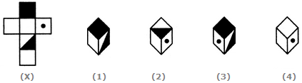
DICE (EXERCISE-A)
Q 13. Choose the box that is similar to the box formed from the given sheet of paper (X).
A.1 and 3 only B.2, 3 and 4 only C.2 only D.3 and 4 only

Slide 27
DICE (EXERCISE-A)
Q 13. Choose the box that is similar to the box formed from the given sheet of paper (X).
A.1 and 3 only B.2, 3 and 4 only C.2 only D.3 and 4 only

Slide 28
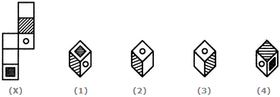
DICE (EXERCISE-A)
Q 14. Choose the box that is similar to the box formed from the given sheet of paper (X).
A.1 and 2 only B.1, 2 and 4 only
C.1 and 4 only D.1, 2 and 3 only

Slide 29
DICE (EXERCISE-A)
Q 14. Choose the box that is similar to the box formed from the given sheet of paper (X).
A.1 and 2 only B.1, 2, 3 and 4 only
C.1 and 4 only D.1, 2 and 3 only

Slide 30

DICE (EXERCISE-A)
Q 15. Choose the box that is similar to the box formed from the given sheet of paper (X).
A.1 and 2 only B.2, 3 and 4 only
C.4 only D.3 and 4 only

Slide 31
DICE (EXERCISE-A)
Q 15. Choose the box that is similar to the box formed from the given sheet of paper (X).
A.1 and 2 only B.2, 3 and 4 only
C.4 only D.3 and 4 only

Slide 32
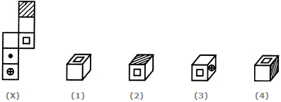
DICE (EXERCISE-A)
Q 16. Choose the box that is similar to the box formed from the given sheet of paper (X).
A.1 only B.2 and 3 only
C.1 and 3 only D.1, 2 and 4 only

Slide 33
DICE (EXERCISE-A)
Q 16. Choose the box that is similar to the box formed from the given sheet of paper (X).
A.1 only B.2 and 3 only
C.1 and 3 only D.1, 2 and 4 only

Slide 34
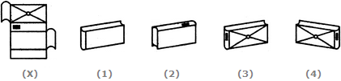
DICE (EXERCISE-A)
Q 17. Which of the following finished patterns can be obtained from the piece of cardboard (X) shown below?
A.1 B.2 C.3 D.4

Slide 35
DICE (EXERCISE-A)
Q 17. Which of the following finished patterns can be obtained from the piece of cardboard (X) shown below?
A.1 B.2 C.3 D.4

Slide 36

DICE (EXERCISE-A)
Q 18. Choose the box that is similar to the box formed from the given sheet of paper (X).
A.1 and 3 only B.2 and 4 only
C.3 and 4 only D.1 and 4 only

Slide 37
DICE (EXERCISE-A)
Q 18. Choose the box that is similar to the box formed from the given sheet of paper (X).
A.1 and 3 only B.2 and 4 only
C.3 and 4 only D.1 and 4 only

Slide 38
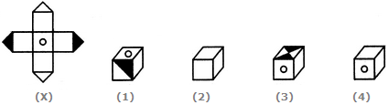
DICE (EXERCISE-A)
Q 19. Choose the box that is similar to the box formed from the given sheet of paper (X).
A.1 only B.2 only
C.3 only D.4 only

Slide 39
DICE (EXERCISE-A)
Q 19. Choose the box that is similar to the box formed from the given sheet of paper (X).
A.1 only B.2 only
C.3 only D.4 only

Slide 40

DICE (EXERCISE-A)
Q 20. When the following figure is folded to form a cube, how many dots lie opposite the face bearing five dots?
A.1 B.2 C.3 D.4

Slide 41
DICE (EXERCISE-A)
Q 20. When the following figure is folded to form a cube, how many dots lie opposite the face bearing five dots?
A.1 B.2 C.3 D.4

Slide 42
DICE (EXERCISE-A)
Q 1.

